Slide 1
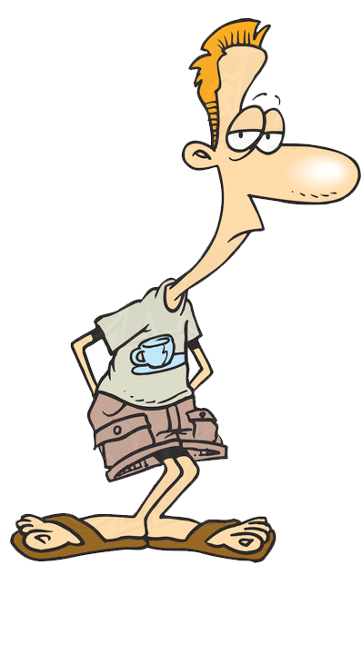
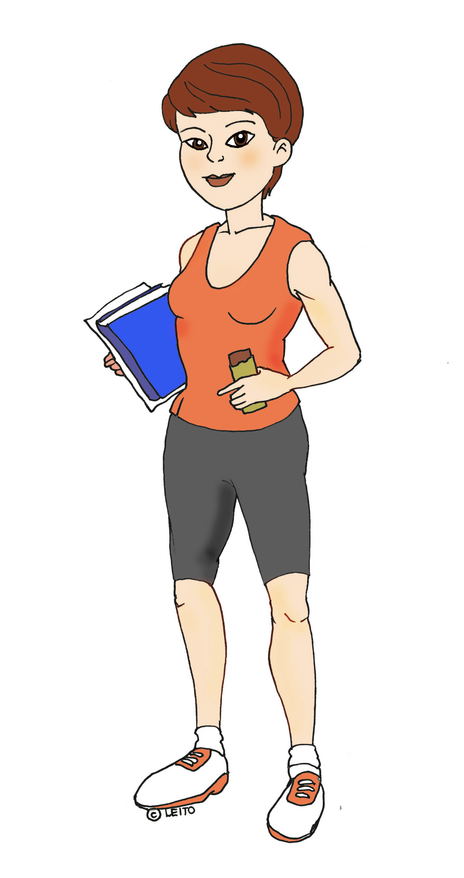
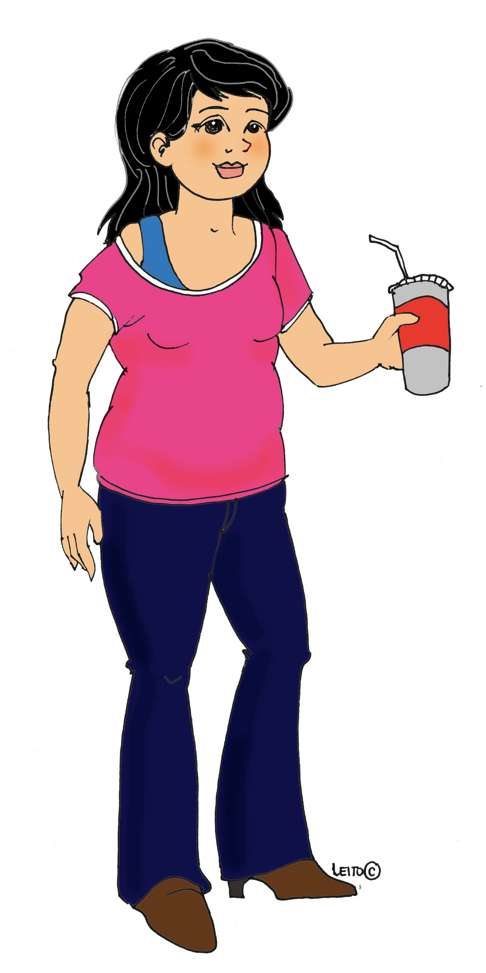
Metabolic Diseases Lesson 2.6
From scrawny to brawny – how metabolism and exercise work together
Edna, Oliver, Mimi…….……………….and Dougie

Slide 2
Do Now
What’s happening with Edna, Oliver and Mimi’s metabolic pathways?
Mimi: Snacks constantly on candy, chips, pretzels and soda
How do Mimi’s snacks affect the energy pool in her blood?
Edna: Constantly running or at the gym.
Where do Edna’s muscles get their energy from when she’s exercising for long periods?
Oliver: Always rushing from place to place and sometimes forgets to eat!
What happens to Oliver’s energy stores when he’s running around and not eating?

Slide 3
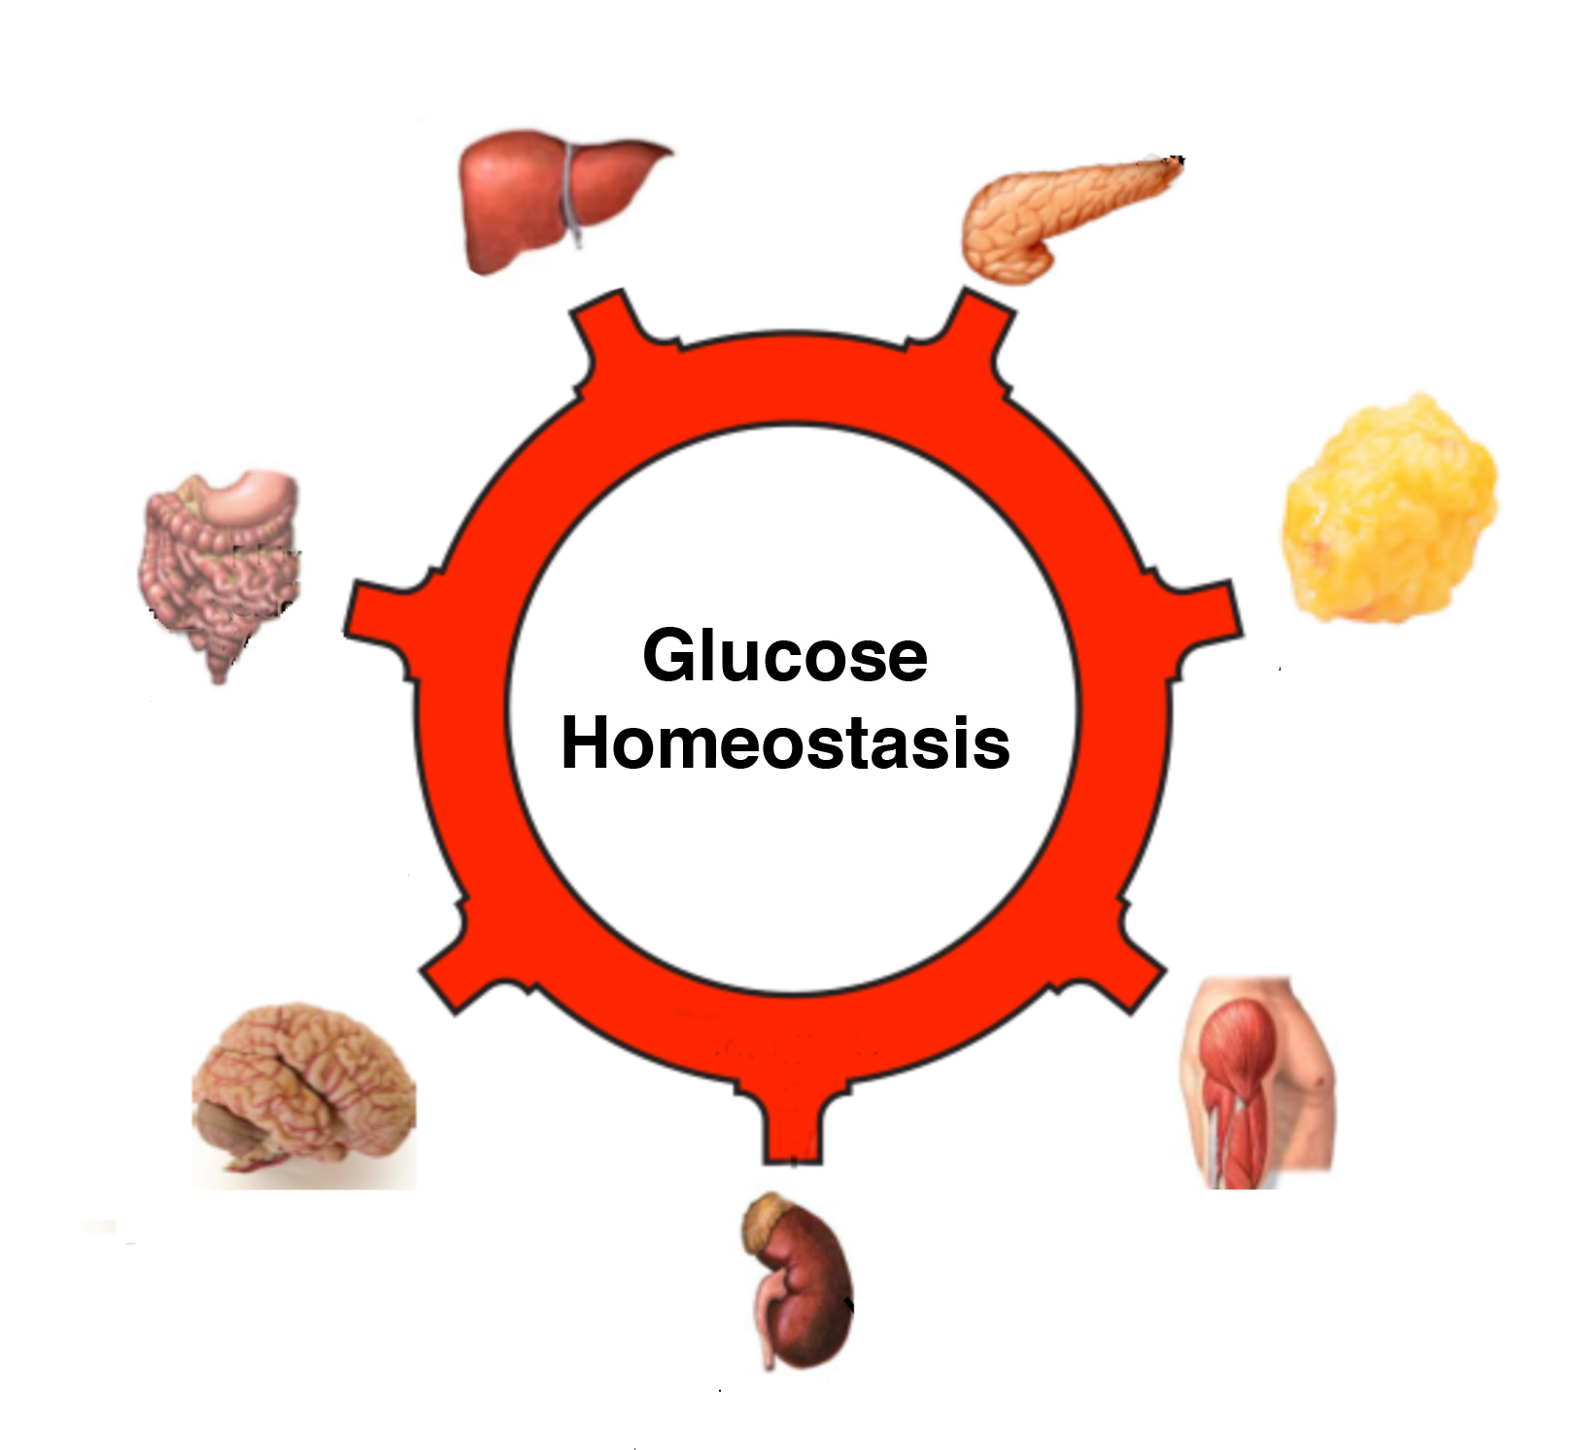
Fill in the following table

Slide 4
Fill in the following table

Slide 5
Activity
Lets apply what we know to our new friend Dougie.
After 15 minutes, each small group will present a different scenario to the class.
Dougie

Slide 6
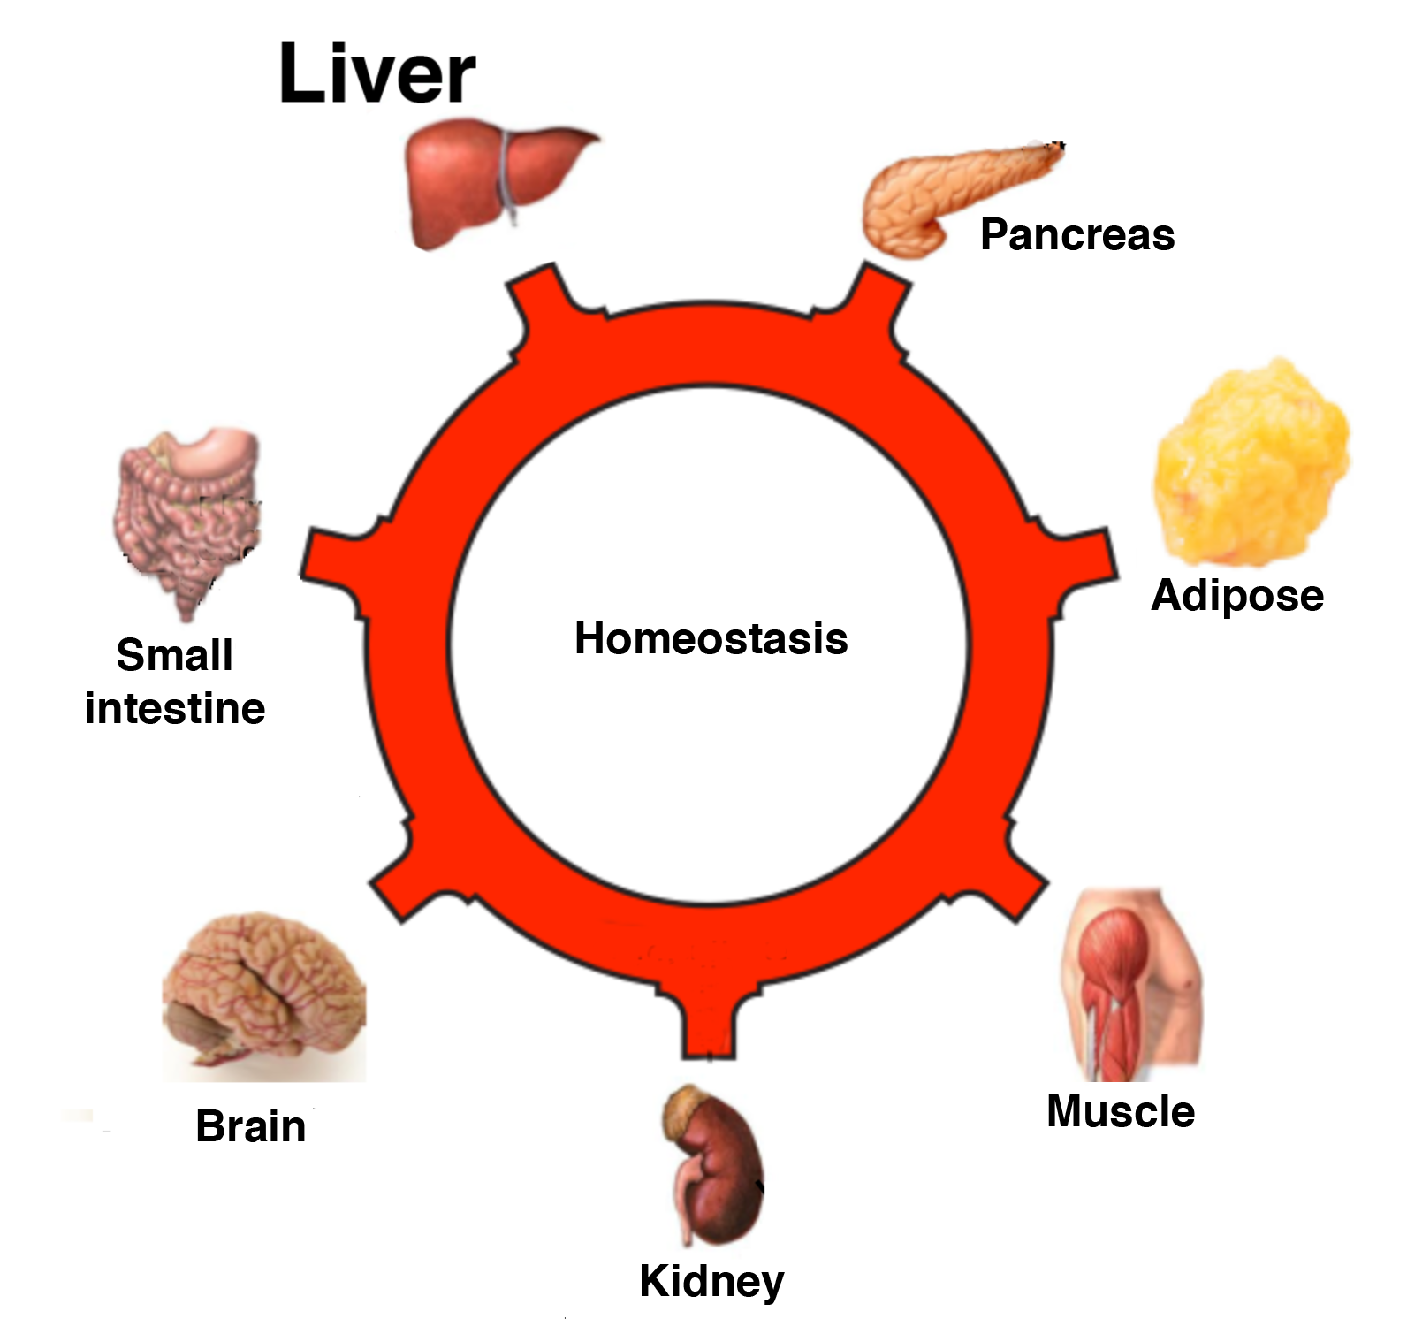
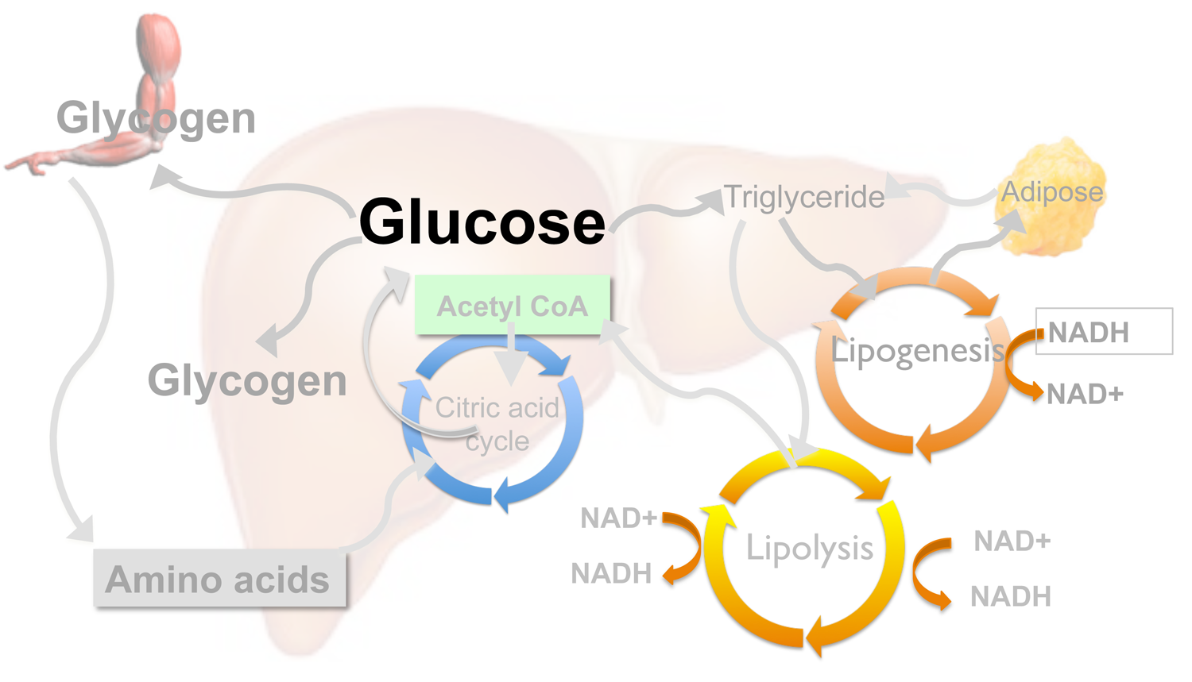
Activity
In all cases use your diagrams to explain Dougie's experiences and to justify your recommendations:

Slide 7
Wrap Up
Debrief the major points using the slides that follow.

Slide 8
1. Dougie filling up on carbs – no exercise
Stores glucose as glycogen
Releases insulin
Makes triglycerides
Digests carbs &
Fats
Stores triglycerides
Stores glucose as glycogen
Needs Glucose!
Releases urea

Slide 9
2. Dougie running a marathon on a high protein diet
Makes glucose from amino acids
Releases glucagon
Breaks down triglycerides
Breaks down protein to amino acids
Breaks down lipids
Needs Glucose!
Releases amino acids
Needs Glucose!
Releases urea

Slide 10
3. Dougie lifting weights – and filling up on carbs
Stores glucose as glycogen
Releases insulin
Uses glycogen
Stores triglycerides
Carbs digested
Needs Glucose!
Uses glycogen
Needs Glucose!
Releases urea

Slide 11
Dougie needs your help!
Use the diagrams to explain to Dougie what he should eat, and when, as he trains on the track and in the gym

Slide 12
2. Dougie running marathons – needs carbs
Makes glucose from amino acids
Releases glucagon
Breaks down triglycerides
Breaks down protein to amino acids
Breaks down lipids
Needs Glucose!
Releases amino acids
Needs Glucose!
Releases urea

Slide 13
3. Dougie lifting weights – needs protein
Stores glucose as glycogen
Releases insulin
Uses glycogen
Stores triglycerides
Carbs digested
Needs Glucose!
Uses glycogen
Needs Glucose!
Releases urea

Slide 14
Homework
Compare the diets of two types of elite athletes:
Marathon runner
Power lifter

